Slide 1
Word Embeddings

Slide 2
Today
Distributional Semantics
Word2Vec

Slide 3
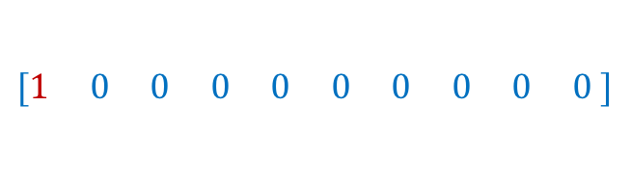
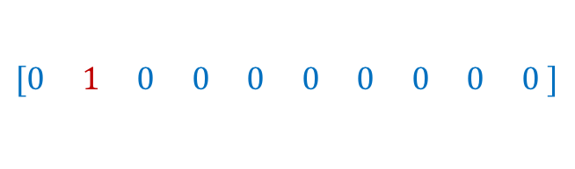
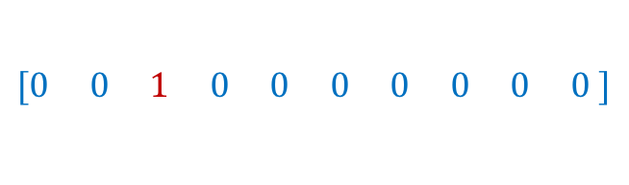
How to represent a word?
Problem: distance between words using one-hot encodings always the same
dog
cat
person
1
2
3
$$[1 0 0 0 0 0 0 0 0 0 ]$$
$$[0 1 0 0 0 0 0 0 0 0 ]$$
$$[0 0 1 0 0 0 0 0 0 0 ]$$
Idea: Instead of one-hot-encoding use a histogram of commonly co-occurring words.
What we see

Slide 4
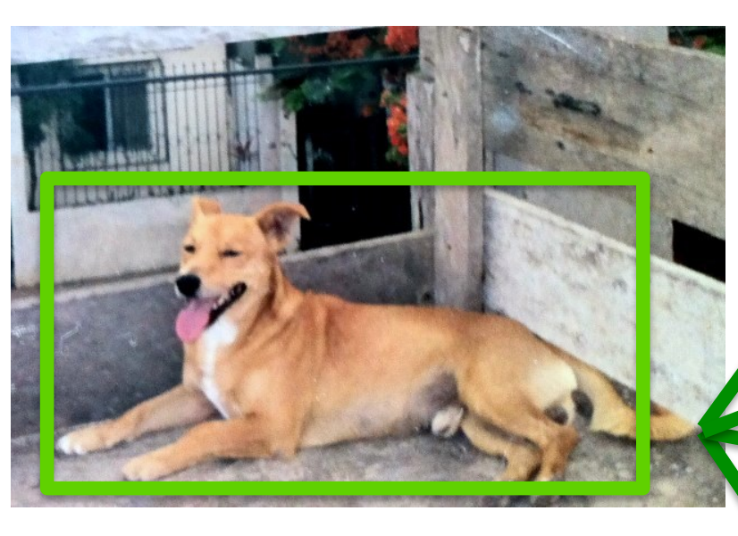
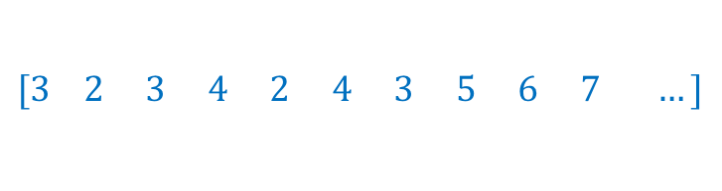
Distributional Semantics
Dogs are man’s best friend.
I saw a dog on a leash walking in the park.
friend
leash
park
walking
walks
food
legs
runs
sleeps
sits
…
His dog is his best companion.
He walks his dog in the late afternoon
…
dog
$$[3 2 3 4 2 4 3 5 6 7 …]$$
What we see

Slide 5
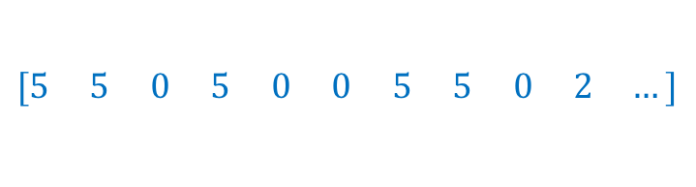
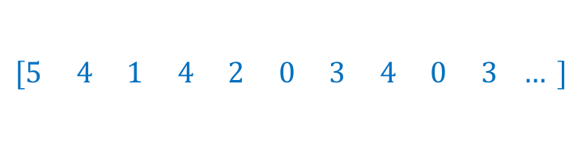
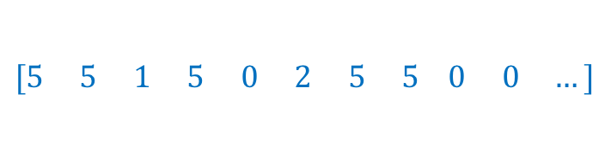
Distributional Semantics
food
walks
window
runs
mouse
invented
legs
sleeps
mirror
tail
…
dog
cat
person
$$[5 5 0 5 0 0 5 5 0 2 …]$$
$$[5 4 1 4 2 0 3 4 0 3 … ]$$
$$[5 5 1 5 0 2 5 5 0 0 …]$$
This vocabulary can be extremely large
What we see

Slide 6
Toward more Compact Representations
food
walks
window
runs
mouse
invented
legs
sleeps
mirror
tail
…
dog
cat
person
$$[5 5 0 5 0 0 5 5 0 2 …]$$
$$[5 4 1 4 2 0 3 4 0 3 … ]$$
$$[5 5 1 5 0 2 5 5 0 0 …]$$
This vocabulary can be extremely large
What we see

Slide 7
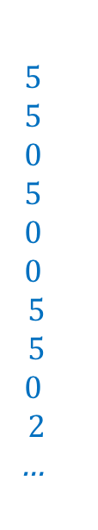
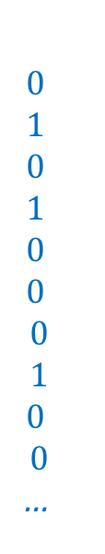
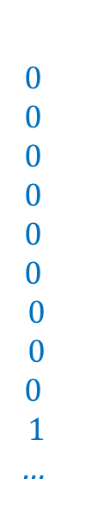
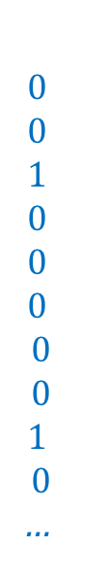
Toward more Compact Representations
$$5$$
$$5$$
$$0$$
$$5$$
$$0$$
$$0$$
$$5$$
$$5$$
$$0$$
$$2$$
…
$$0$$
$$1$$
$$0$$
$$1$$
$$0$$
$$0$$
$$0$$
$$1$$
$$0$$
$$0$$
…
$$0$$
$$0$$
$$0$$
$$0$$
$$0$$
$$0$$
$$0$$
$$0$$
$$0$$
$$1$$
…
$$0$$
$$0$$
$$1$$
$$0$$
$$0$$
$$0$$
$$0$$
$$0$$
$$1$$
$$0$$
…
dog =
=
w1
+ w2
+ w3
+ …
What we see
legs, running, walking
tail, fur,
ears
mirror, window, door

Slide 8
Toward more Compact Representations
dog =
w1
w2
w3
The basis vectors can be found using Principal Component Analysis (PCA)
What we see

Slide 9
What is word2vec?
word2vec is not a single algorithm
It is a software package for representing words as vectors, containing:
Two distinct models
CBoW
Skip-Gram (SG)
Various training methods
Negative Sampling (NS)
Hierarchical Softmax
A rich preprocessing pipeline
Dynamic Context Windows
Subsampling
Deleting Rare Words
Slide by Omer Levy
Notes:
Now, we’re going to focus on Skip-Grams with Negative Sampling,
Which is considered the state-of-the-art.

Slide 10
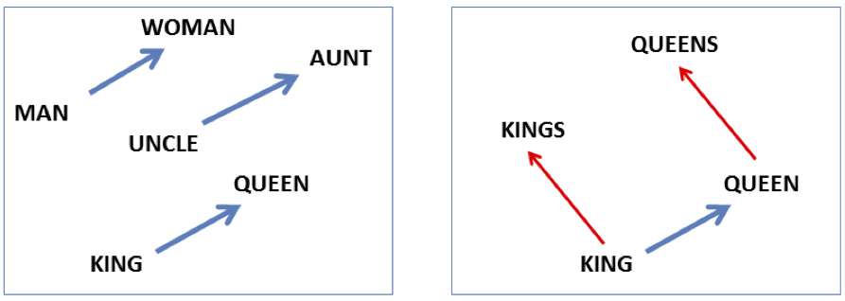

Embeddings capture relational meaning!
vector(‘king’) - vector(‘man’) + vector(‘woman’) $≈$vector(‘queen’)
vector(‘Paris’) - vector(‘France’) + vector(‘Italy’) $≈$ vector(‘Rome’)
Slide by Dan Jurafsky

Slide 11
Skip-Grams with Negative Sampling (SGNS)
Marco saw a furry little wampimuk hiding in the tree.
“word2vec Explained…”
Goldberg & Levy, arXiv 2014
Notes:
So, how does SGNS work?
Let’s say we have this sentence,
(This example was shamelessly taken from Marco Baroni)

Slide 12
Skip-Grams with Negative Sampling (SGNS)
Marco saw a furry little wampimuk hiding in the tree.
“word2vec Explained…”
Goldberg & Levy, arXiv 2014
Notes:
And we want to understand what a wampimuk is.

Slide 13

Skip-Grams with Negative Sampling (SGNS)
Marco saw a furry little wampimuk hiding in the tree.
words contexts
wampimuk furry
wampimuk little
wampimuk hiding
wampimuk in
… …
$D$ (data)
“word2vec Explained…”
Goldberg & Levy, arXiv 2014
Notes:
What SGNS does is take the context words around “wampimuk”,
And in this way,
Constructs a dataset of word-context pairs, D.

Slide 14

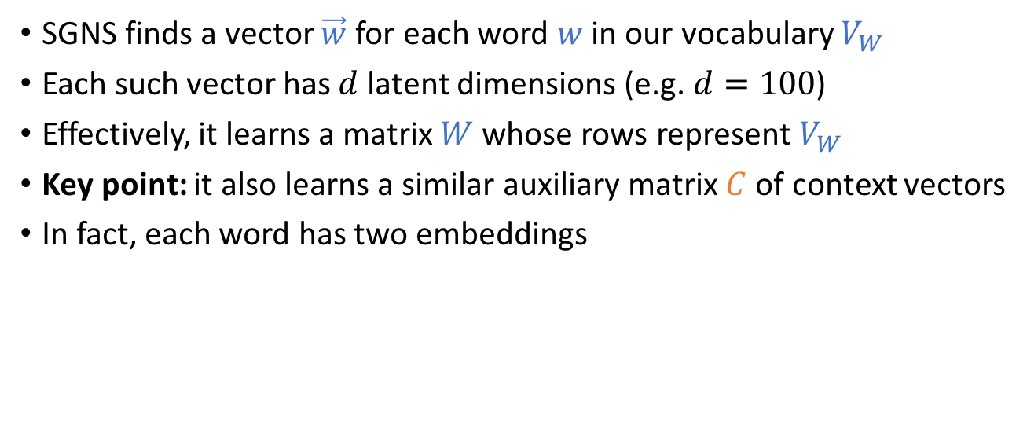







Skip-Grams with Negative Sampling (SGNS)
SGNS finds a vector $\vec{w}$ for each word $w$ in our vocabulary $V_{W}$
Each such vector has $d$ latent dimensions (e.g. $d=100$)
Effectively, it learns a matrix $W$ whose rows represent $V_{W}$
Key point: it also learns a similar auxiliary matrix $C$ of context vectors
In fact, each word has two embeddings
$$d$$
$$d$$
$$W$$
$w$:wampimuk $=(−3.1, 4.15, 9.2, −6.5,…)$
$$C$$
$$V_{W}$$
$$≠$$
$$V_{C}$$
$c$:wampimuk $=(−5.6, 2.95, 1.4, −1.3,…)$
“word2vec Explained…”
Goldberg & Levy, arXiv 2014
Notes:
Now, using D,
SGNS is going to learn a vector for each word in the vocabulary
A vector of say… 100 latent dimensions.
Effectively, it’s learning a matrix W,
Where each row is a vector that represents a specific word.
Now, a key point in understanding SGNS,
Is that it also learns an auxiliary matrix C of context vectors
So in fact, each word has two different embeddings
Which are not necessarily similar.

Slide 15
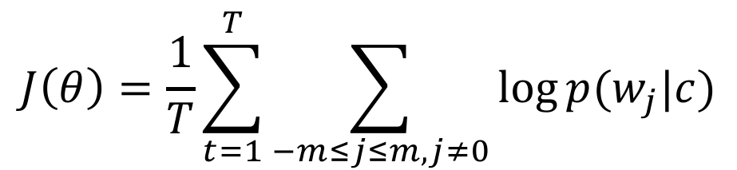
Word2Vec Objective
$$J\left(θ\right)=\frac{1}{T}\sum_{t=1}^{T}{\sum_{−m≤j≤m, j≠0}{\log{p(w_{j}|c)}}}$$

Slide 16
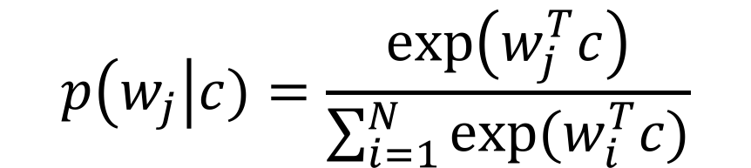
Word2Vec Objective
$$p\left(w_{j}\right|c)=\frac{\exp\left(w_{j}^{T}c\right)}{\sum_{i=1}^{N}{exp⁡(w_{i}^{T}c)}}$$

Slide 17
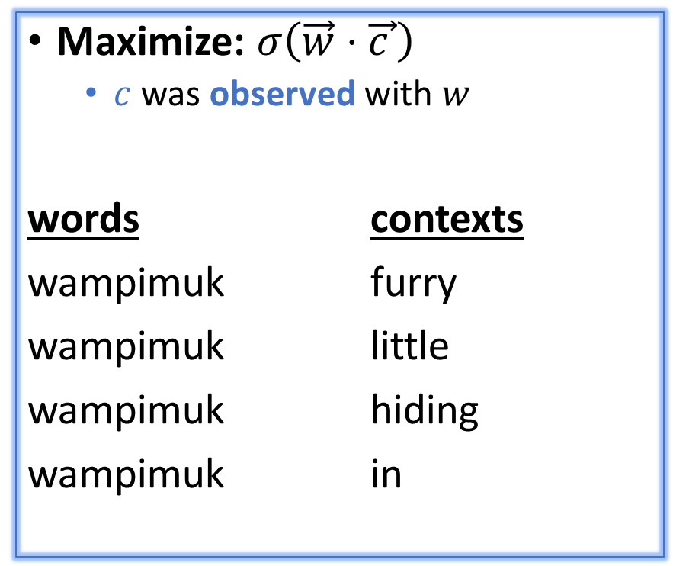
Skip-Grams with Negative Sampling (SGNS)
Maximize: $σ\left(\vec{w}⋅\vec{c_{ }}\right)$
$c$ was observed with $w$
words contexts
wampimuk furry
wampimuk little
wampimuk hiding
wampimuk in
“word2vec Explained…”
Goldberg & Levy, arXiv 2014
Notes:
…SGNS maximizes the similarity between word and context vectors that were observed together.

Slide 18
Skip-Grams with Negative Sampling (SGNS)
Maximize: $σ\left(\vec{w}⋅\vec{c_{ }}\right)$
$c$ was observed with $w$
words contexts
wampimuk furry
wampimuk little
wampimuk hiding
wampimuk in
Minimize: $σ\left(\vec{w}⋅\vec{c_{ }}′\right)$
$c′$ was hallucinated with $w$
words contexts
wampimuk Australia
wampimuk cyber
wampimuk the
wampimuk 1985
“word2vec Explained…”
Goldberg & Levy, arXiv 2014
Notes:
…and minimizes the similarity between word and context vectors hallucinated together.

Slide 19
Skip-Grams with Negative Sampling (SGNS)
“Negative Sampling”
SGNS samples $k$ contexts $c^{′}$ at random as negative examples
“Random” = unigram distribution
$$P_{ }^{ }\left(c\right)=\frac{\#c}{\left|D\right|}$$
Spoiler: Changing this distribution has a significant effect
Notes:
Now, the way SGNS hallucinates is really important.
It’s actually where it gets its name from.
For each observed word-context pair,
SGNS samples k contexts at random,
As negative examples
Now, when we say random, we mean the unigram distribution
And Spoiler Alert: changing this distribution has quite a significant effect.

Slide 20
Questions?

